Slide 1
Parking FTW
Because parking is cool.

Slide 2

Overview of our product
Our product is a a car park finder web application.
Notes:
Our product aims to provider users with an easy way of finding suitable and available car parks for parking - especially during peak hours.
Moreover, they can earn points for using our apps which can then be used for earning attractive rewards.

Slide 3
Expected users
Car owners
Want to find available parking ASAP
Wants to “reserve” carpark
Wants direction to reserved car park
Wants stuff for free/discounted price :)
Corporate users
Wants to promote their products by selling at discounted prices to users

Slide 4
Chosen Use Cases

Slide 5
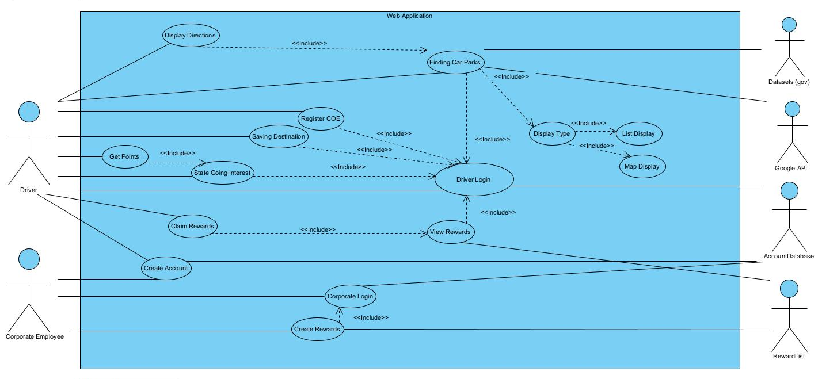
Use Case Diagram
Mapbox
Notes:
Our product aims to provider users with an easy way of finding suitable and available car parks for parking - especially during peak hours.
Moreover, they can earn points for using our apps which can then be used for earning attractive rewards.

Slide 6
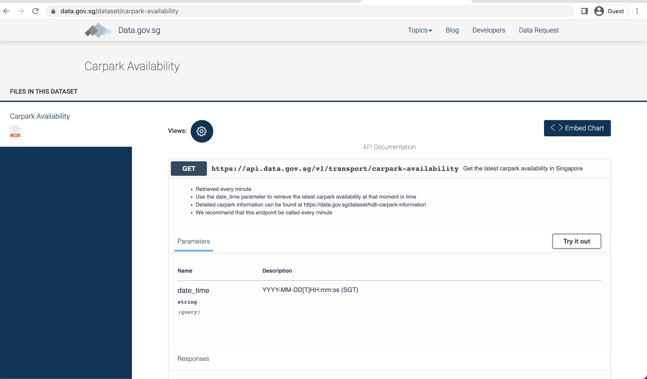
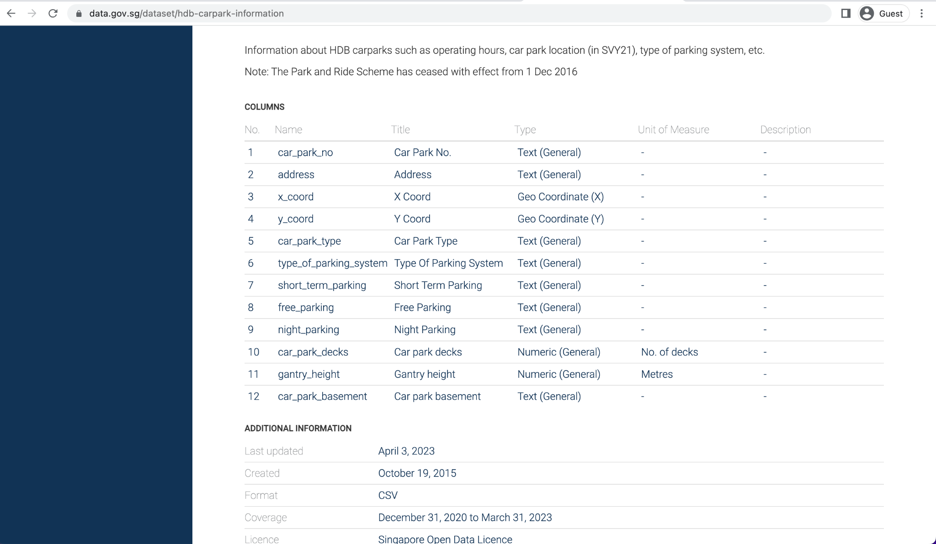
DATASETS WE USED
CARPARK AVAILABILITY (5min)
2. HDB CARPARK INFORMATION (1 day)
https://data.gov.sg/dataset/carpark-availability
https://data.gov.sg/dataset/hdb-carpark-information

Slide 7
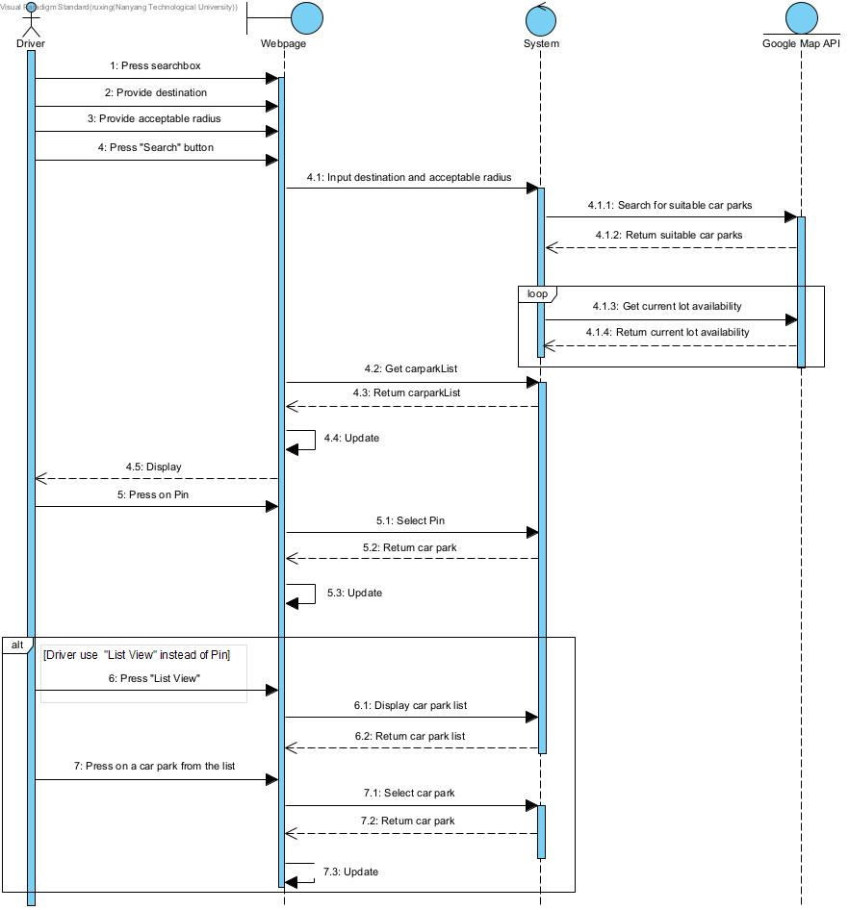
Example Use Cases
Mapbox
Bubbles
Bubbles
Bubbles

Slide 8
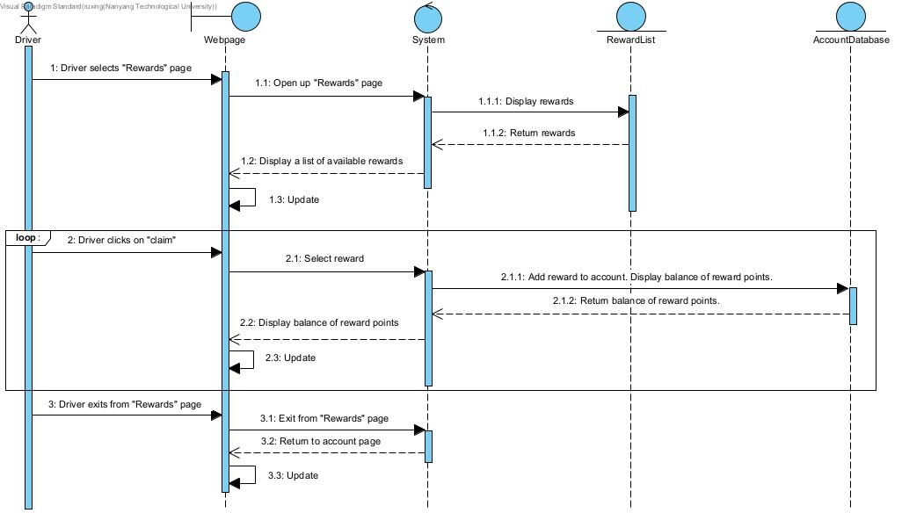
Example Use Cases

Slide 9
Implementation (Live Demo)

Slide 10
Testing Phase

Slide 11
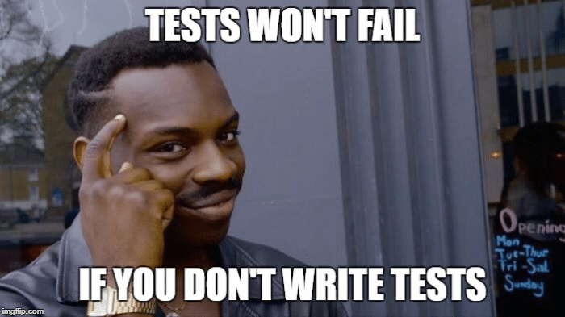
Finding Vulnerabilities
>20 test cases
All features tested
Target edge cases
Discover and rectify bugs
Increase security and robustness

Slide 12

Defenses
Strong Password Requirement
Password Hashing
Defend against Buffer Overflow
Overwrite Protection through
HTML Email Typing
CSRF Token

Slide 13
System Architecture

Slide 14
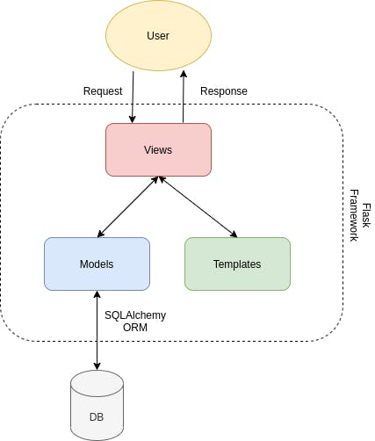
System Architecture (MVT)
MVT Stands for Model View Template
Backend: Flask
Frontend: Pure HTML + CSS + JS + Bootstrap
DB: SQLite + SQLAlchemy (ORM)
Map API: Mapbox
Geocoding
Route Finding
Map canvas Rendering

Slide 15
Good Software Engineering Practices

Slide 16

Teamwork
Divide team into 2 smaller groups
“Doc” team
“Coding” team
Leverage each team member’s strength
Virtual meeting every 1 week/2 week to catch up

Slide 17

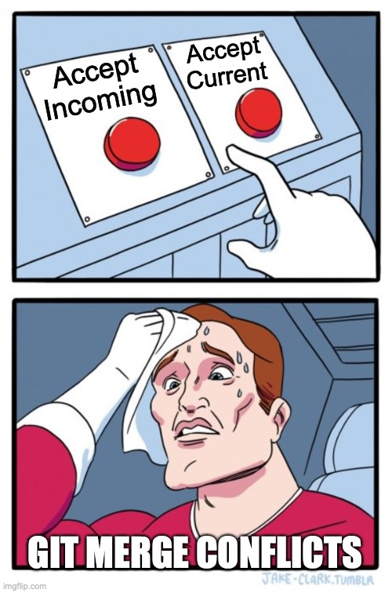
Github (better than svn)
Project management/ Progress tracking
Use branches - work on codebase without the fear of merge conflict (most of the time)
Use Github Issues
Divide work into multiple “issues”
Assign each issue to each member
Helps break up the work

Slide 18
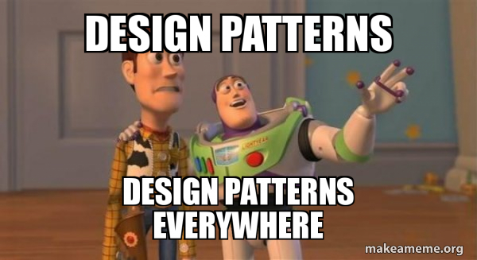
Code & Database
3NF Normalised (SC2207)
Design patterns
Observer, strategy, etc
Class inheritance
E.g. UserMixin for class model (for sqlalchemy)
Divide common files into different folders
html to “templates”
js, css, img to “static”

Slide 19
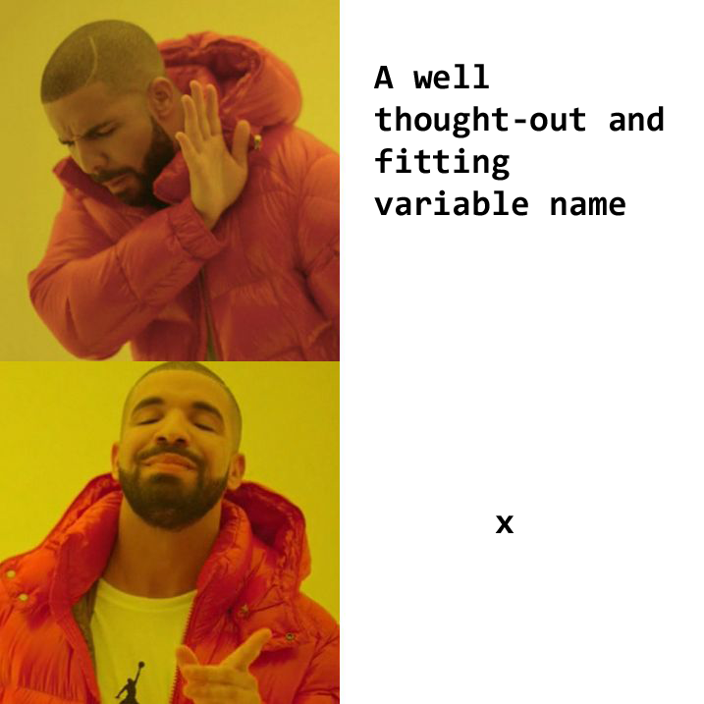
Code & Database
Standardize to reduce confusion
Good variable/function/file names
Document only when needed
When the code written is not immediately obvious
When the code does not/will not works as expected
Refactor, refactor, refactor
You can’t good code in the first try.
Reduce repetition

Slide 20

THANK YOU

